Slide 1


Automating Android Apps
By Brian Kitchener

Slide 2

Automating Apps
- Introduction to Test Automation
- Overview of Appium
- The WebDriver API
- Locating UI Elements
- Unit Testing Frameworks
- Page Objects
- Test Frameworks
- Advanced Features

Slide 3
Schedule
- 9:30 - 10:30 Lecture
- 10:30 - 11:00 Work Time
- 11:00 - 12:00 Lecture
- 12:00 - 12:30 Work Time / Q&A

Slide 4






- You will need :
- Java SDK
- Eclipse IDE
- Maven
- Appium.io
- Selenium
- JUnit/TestNG

Slide 5
What are we building?
Tests built in TestNG / JUnit
Tests use the WebDriver API
Appium is a node.js server
USB Device or Emulator

Slide 6
Fundamental Precepts of Test Automation
1) Automation is Code. Treat it as such.
2) You cannot test everything. Don’t even try.
3) Reliability is more important than coverage.
4) Make the smallest tests possible.
5) Finding the elements is half the battle.
6) Timing is everything.
7) You need to know why your test failed.
8) Choose your tool carefully, you will be stuck with it.
9) When all else fails, build a hook in the application.
10) Don’t build a test if no one cares that it fails.

Slide 7
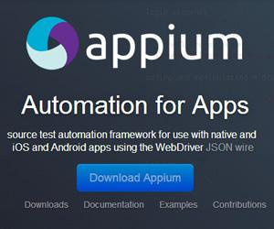
Appium Overview
- http://appium.io
- Open source
- Node.js server
- Selenium 2 / WebDriver API
- Emulators and Real Devices
- Native and Hybrid Apps
- Web Browsers - Chrome and Safari
- Being merged into Selenium 3
- Selenium GRID Support

Slide 8
Web Automation
- Selenium 2.0
- WebDriver API
- Execute tests locally or remote
- Selenium Jar
- Most Languages supported
-Java, C#, Ruby, Python, Perl, Javascript, and more.
- Not a testing tool, just a Browser API.
- Unit Testing Framework of choice
- Custom frameworks to support additional functionality.

Slide 9
Selenium 2 API’s
- WebDriver API
- Contains methods for system manipulation
- Finds elements
- WebElement API
- Contains methods for manipulating an element
- Click, SendKeys, etc.
- Action API
- Complicated UI actions like Swipe, etc.
Appium Library can be used alternatively
- HTTP Messages are the same
- Different function names

Slide 10
Example Code
WebElement el = driver.findElement(By.name("Add Contact"));
el.sendKeys("Some Name");
el.click();
driver.swipe(100, 500, 100, 100, 2);
driver.findElementByName("Save").click();

Slide 11
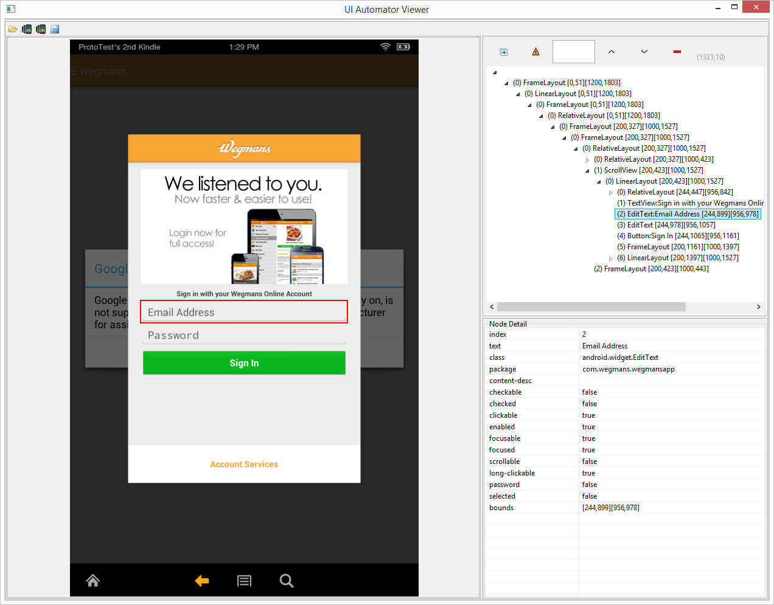
Locating Elements
- By.Id(“resourceId”)
- By.Name(“text visible”)
- By.Xpath(“//EditText[3]”)

Slide 12
WebDriver is a Library
WebDriver API provides no ability to :
- Perform validations
- Deal with non-app windows
- Fetch Data
- Look at HTTP Traffic
- Execute a test
- Maintain object repository

Slide 13
Unit Testing Frameworks
JUnit VS TestNG
- Both are Viable
- TestNG better for UI automation
- Provide ability to execute
- Annotations inject functionality into our tests

Slide 14
TestNG
@BeforeClass - Instantiate Objects, Fetch Data
@AfterClass - CleanUp
@BeforeMethod - Instantiate Driver
@AfterMethod - Close Driver, Log Test Info
@BeforeTest - Start external tools
@AfterTest - Quit everything

Slide 15
Appium Info
Appium has both a UI and command line tool
- Either work
Capabilities can be set on startup, or from the test.

Slide 16
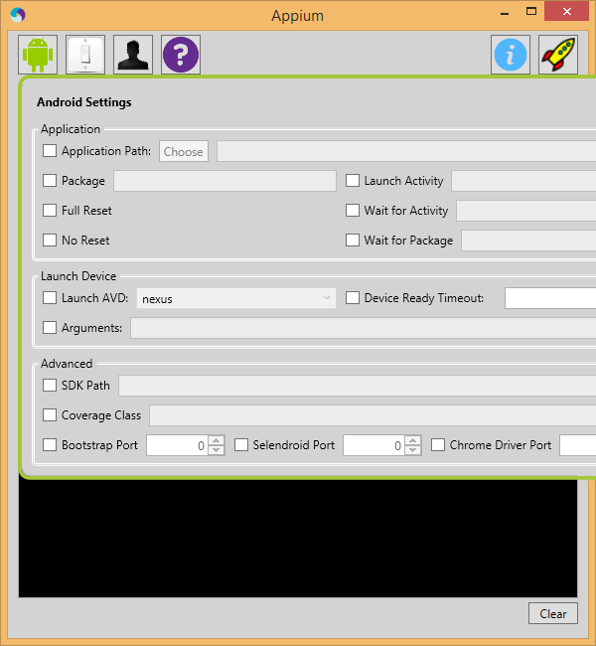
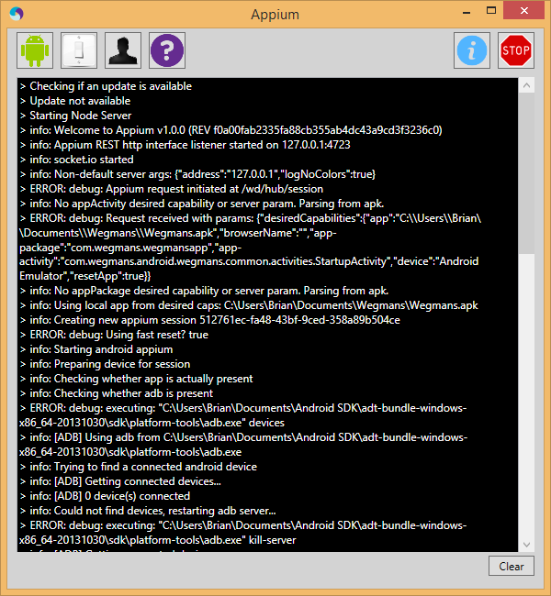

Slide 17
Connecting to Appium
DesiredCapabilities capabilities = new DesiredCapabilities();
capabilities.setCapability(CapabilityType.BROWSER_NAME, "");
capabilities.setCapability("deviceName","Android Emulator");
capabilities.setCapability("platformVersion", "4.4");
capabilities.setCapability("platformName","Android");
capabilities.setCapability("app", app.getAbsolutePath());
capabilities.setCapability("app-package", "com.example.android.apis");
capabilities.setCapability("app-activity", ".ApiDemos");
driver = new RemoteWebDriver(new URL("http://127.0.0.1:4723/wd/hub"), capabilities);

Slide 18
Connecting to Appium Browser
DesiredCapabilities capabilities = new DesiredCapabilities();
capabilities.SetCapability("device", "android");
capabilities.SetCapability("platform", "windows");
capabilities.SetCapability("app", "chrome");
RemoteWebDriver driver = new RemoteWebDriver(new Uri("http://127.0.0.1:4723/wd/hub"), capabilities);

Slide 19
Exercise 1
Launch Appium
Download Sample App
Inspect App UI
Create a TestNG Test
Instantiate a Driver
Find and Click Elements

Slide 20
Common Problems
Hundreds of lines of click commands are hard to decipher!
Lots of code duplication.
Locators scattered throughout our code
No code reusability or organization
No configurability
No diagnostic information

Slide 21
Home Page
Click Login Link
Click Profile Link
Login Page
Profile Page
Log In
Click Home
Invalid
Login
Reset
Password
Edit Profile
Save
Changes
Cancel
Edit
Click Forgot Password
Password Page
Edit Profile Page

Slide 22
Method Map
A large automation suite will have thousands of reusable methods.
Each method will only work if the application is in a specific state.
Each method starts and ends on a page.
Each method is stored in the page it starts on
Each method returns another page

Slide 23
Page Objects
Store information about the AUT
Provide an organizational system
Reusable functions
Single point of update
UI Elements defined
Application UI Map

Slide 24
Page Object details
Define each UI element with locator
Define reusable methods
Data is passed in through parameters
Tests don’t use driver
Page Objects don’t read from the config
Methods return other page objects!

Slide 25
Page Object Example
public class LoginPage{
Element emailAddress = new Element(By.name("Email Address"));
Element password = new Element(By.xpath("//EditText[2]"));
Element accountServices = new Element(By.name("Account Services"));
Element signIn = new Element(By.name("Sign In"));
public void loginAsUser(String username, String password)
{
emailAddress.sendKeys(username);
password.sendKeys(password);
signIn.click();
}
public void loginAsGuest()
{
accountServices.click();
}
}

Slide 26
Reusing page objects
Page objects can be built using ‘components’ – aka other page objects!
Header, Footer, Search bar, etc.
Extend and override to share functionality
Logged in Page vs Logged out page

Slide 27
Testing Framework
Standardized config file
Tests extend a super class
Page Objects may extend a super class
Standard Environmental functions
Additional Test Diagnostic Information
Database / REST API methods
Custom Application Hooks
Custom Functionality

Slide 28
Configurability
Environment Info
Store test data
- Usernames, passwords, etc.
Disk Storage
- Generated data (usernames)
Configure “optional” features
- HTTP Proxy, Appium startup
Logging
- Command Log, debug info, etc

Slide 29
Test Super Class
Instantiates driver per test
Fetches data (db, api)
Starts/Stops External Processes
Quits driver after each tests
Logs screenshot / AUT info
Check for test failure

Slide 30
Exercise 2
Create several page objects for the beginning pages of the app
Create several tests that use the page object methods in a function chain
Create a test super class that launches driver before each test
Use a config file to store test settings

Slide 31
Selenium GRID
Setup a cluster of Appium machines
Run tests in parallel
Run tests against different devices / emulators
Share test machines across an organization
Desired Capabilities specify which machine the test will run on!

